Slide 1
The design of Copyleaks.com
Gia Laramee

Slide 2
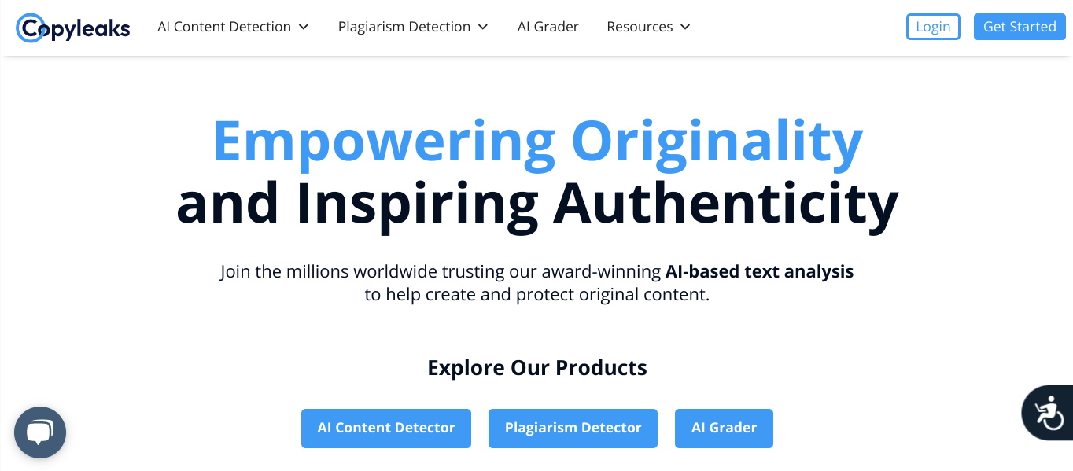
Background
What do they do?
Detect if content was written by a human or AI
Identifies plagiarism
Grades tests/papers
Who are they?
Founded by Yehonatan Bitton students in 2015

Slide 3


User Base
Students
All education levels
test/paper grader
Anyone writes papers/essays
Plagiarism detector
AI detector
AI test grader

Slide 4
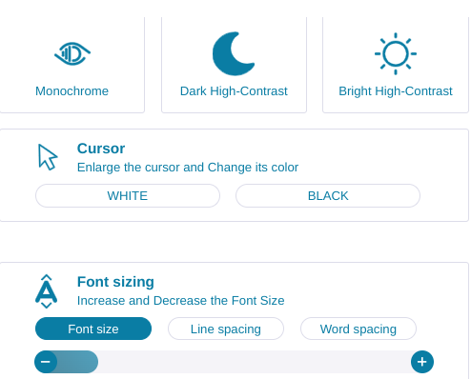
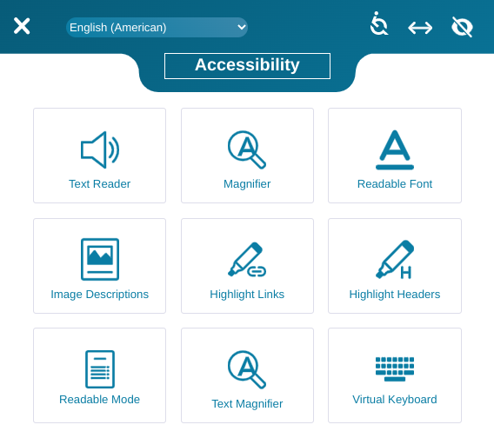
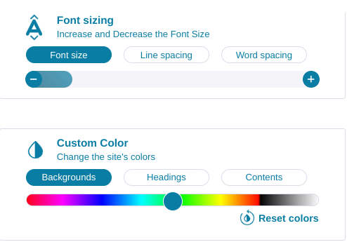
Accessibility
Highly accessible
Reader, color contrast, magnifier
Multiple languages

Slide 5
User Flow

Slide 6
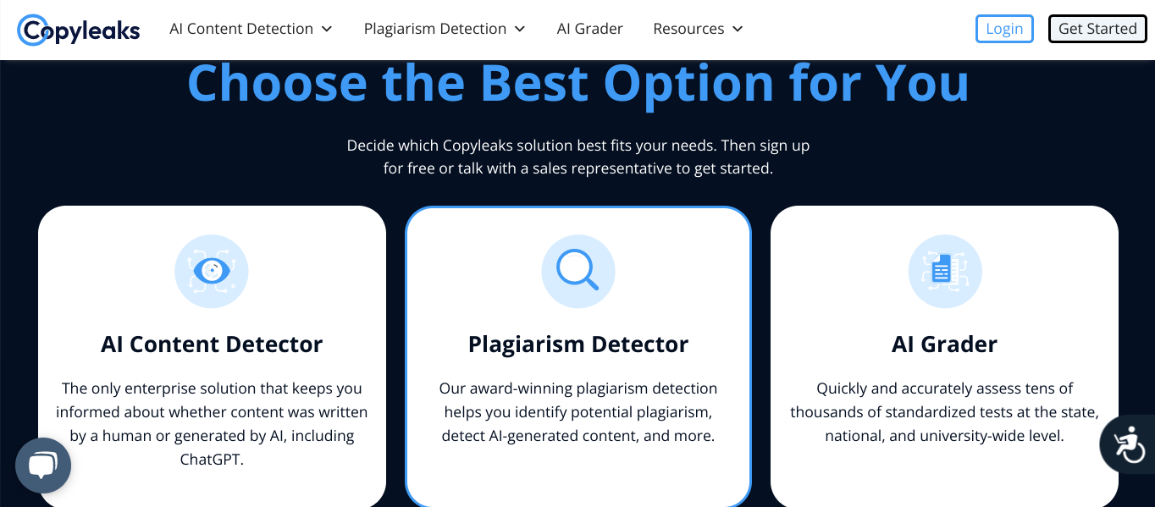
Home Page
If a user is not logged in:
Provides an overview
Has a chat pop up window for assistance
Has a clear banner
Includes sign-up/sign-in
Menu bar to select other options

Slide 7
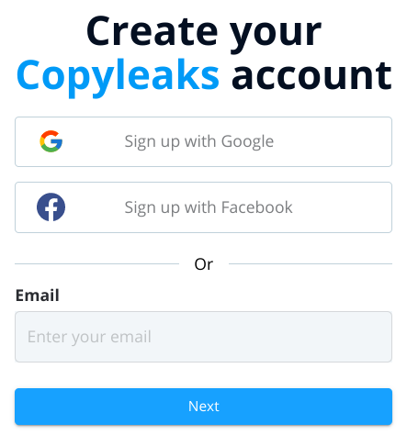
Sign-up Page
Integrated with Google Sign-in and Facebook Sign-in
Simple Account Creation
First Name
Last Name
Email
Password
Agree to terms and service

Slide 8
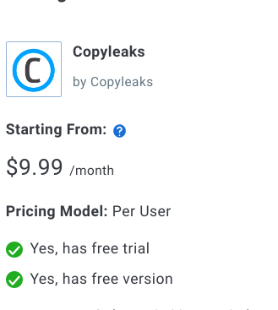
Payement
Tiered subscription model
Basic
Free
Plus
$9.99 a month

